Slide 1
Bias & Morality Judgment AI
Evan Geissler

Slide 2
Presentation Overview
The Trolley Problem & Why it’s Relevant to AI
Technologies Used
Project Overview
Scope
Algorithms, Techniques, & Diagrams
Demonstration
Conclusion
Questions

Slide 3
The Trolley Problem
Thought experiment which challenges:
Ethics & Beliefs
Morals
How people react to difficult decisions
In applied cases, to see AI reactions
Makes people question their choice by thinking:
What will others think?
Is my choice morally ok?
Does this affect who I am?
Will anyone see?

Slide 4
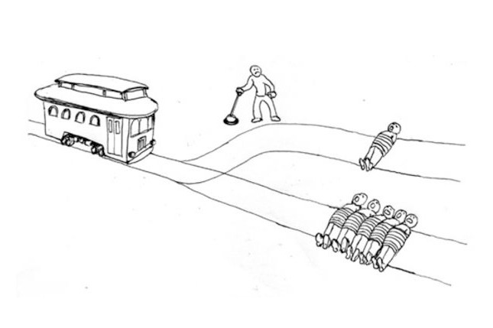
The Trolley Problem

Slide 5
Why is it Relevant to AI?
Self Driving Cars
Accident avoidance
Lessen accident outcomes (predefined to some extent)
Robotics (what’s right and wrong)
AI usually modeled by what humans think is right
Isaac Asimov’s Three Laws of Robotics
“A robot cannot injure a human being, or, through inaction, allow a human being to come to harm.”
Smarter/More interactive AI Decision making

Slide 6

Technologies Used
C++ using Apple’s Xcode
What I’m used to
Time constraints
Easily used on MacBook
Command Line Interface
Graphical UI not needed
Text based output
Text wrapping is a con of Apple’s terminal

Slide 7
Project Overview
1. Information about a user is gathered
Sex, weight, age, etc.
2. Program then asks a user initial, hard set questions involving a car with different choices:
A Self-Driving Car is heading down a road when 1 person walks in front of the car. The car will either continue its path OR the car can swerve off the road hitting 2 people. Should the car:
a. Continue its course OR
b. Swerve off the road?

Slide 8
Project Overview
3. The AI then calculates biases based on:
User input (which choice did they make)
User information (sex, age, weight, etc.)
4. Next, the AI uses Heuristics to ask questions if:
Heuristics are available AND
Meets minimum requirements
OR The AI finds a question to ask based on a user’s current calculated biases
AI always wants them to pick b

Slide 9
Project Overview
5. A user will then choose an answer
6. The AI prints initial and final results
7. AI saves answers for future heuristics and learns for future trials

Slide 10
Scope
AI to ask semi-specific questions
AI has the ability to learn from past trials
File saving/reading
Machine Learning
Heuristics
AI can ensure repeated or bad questions don’t happen
Directive Management
Provide some feedback to improve AI

Slide 11
Algorithms & Techniques
1. Directive Management
2. Heuristics (if possible)
3. Machine Learning

Slide 12
1. Directive Management
Keeps user and program on track to next question
Ensures answers aren’t answered too fast
Ensures questions aren’t repeated by:
1. Saving questions that are asked
2. Checking next question generated against all previous questions asked
3. If question has been asked, ask the next possible question

Slide 13
2. Heuristics
Uses information of past trials that includes:
Continue choice
Swerve choice
Number of people asked
% success rate
Asks questions that will most likely lead to success
Asked before calculated choices IF the following is true about a question:
1) +60% success rate (# of times b selected)
2) 5 or more people asked
Improves with more information gathered

Slide 14
3. Machine Learning
Updates its data of past questions and their success:
Adds and updates questions to data log
Increases number of people asked
Recalculates % success rate
By improving and using data gives higher chance of success, less random prediction, etc.
Questions still have chance to be unsuccessful
Most useful with many trials

Slide 15
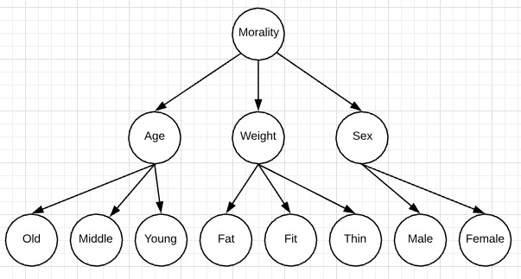
Diagrams

Slide 16
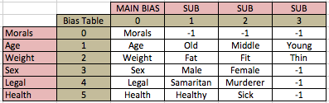
Diagrams
Converted tree into 2D array
Used -1 as null place holders for spots that had no bias
Easy to add new biases
Fast to find bias since exact location of bias is known:
Example: Murderer at position i=4 j = 2 has find code of 42

Slide 17
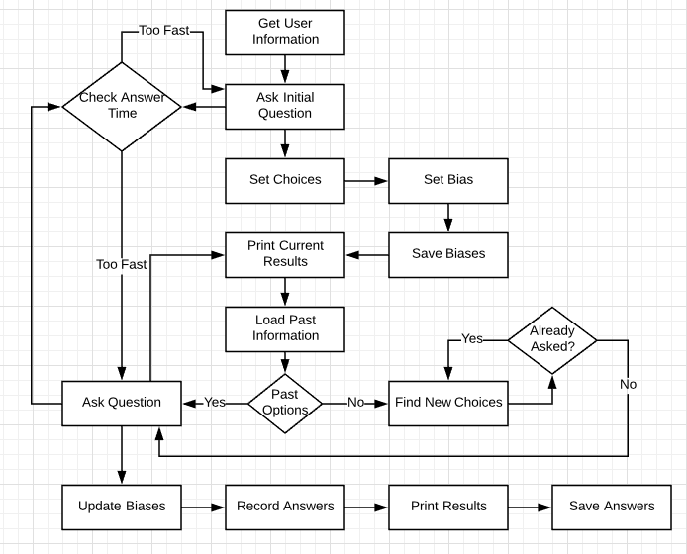

Slide 18
Demonstration

Slide 19
Conclusion
AI semi-successful
Need more diverse group of testers than like minded people
Becomes more successful when:
More people asked (better heuristics),
More specific questions asked (better prediction),
Better questions that have more population bias
Example: murderers, sick people, racists, etc.
Success rate about 0% with general biases
Success rate >50% with better specific biases
Example: Murderers, sick people, etc.

Slide 20
Conclusion
AI not successful due to different reasons regardless if bias calculations work due to:
Assumptions about a person’s reactions
Person has specific biases
Person not answering truthfully
Person does not care
A choice not properly reflecting a person’s stance
Example: AI asks 1 Male Vs. 2 Female.
User picks 1 male resulting in a bias against males
However, user may have picked 1 male simply to save 2 people over 1

Slide 21
Future Improvement
Add more specific questions and reasoning
Example: Sick old criminal vs. Young healthy child
Example: “Swerving the car does not make you a bad person”
Better user interactions
Use of graphical interface
Audio clips, live video, or animations instead of text
Can sway user’s input (peer pressure)
More user input for better heuristics

Slide 22
Questions?

Slide 23
References
Matt. “Robots and AI.” NASA, NASA, robotics.nasa.gov/students/ai_robotics.php.
Feldman, Brian. “The Trolley Problem Is the Internet's Most Philosophical Meme.” Select All, 9 Aug. 2016, nymag.com/selectall/2016/08/trolley-problem- meme-tumblr-philosophy.html.
Lester, J. C. (2013). Serious Games Get Smart: Intelligent Game-Based Learning Environments. AI Magazine, 34(4). Retrieved from https:// www.aaai.org/ojs/index.php/aimagazine/issue/ view/204

